Slide 1
Conserving Africa’s Wild Fauna and Flora
AFRICAN UNION COMMISSION
DEPARTMENT OF RURAL ECONOMY AND AGRICULTURE

Slide 2

African Strategy on Combating Illegal Exploitation and Illegal Trade in Wild Fauna and Flora
The AU Summit adopted in June 2014 the EX.CL/Dec.832 (XXV) in Malabo. The Decision, specifically targets the illicit exploitation and trade in African wild fauna and flora and calls upon the Commission in collaboration with the relevant partners to develop an African Strategy on Combating Illegal Exploitation and Illegal Trade in Wild Flora and Fauna.
In June 2015, the AU Summit through Decision EX.CL/Dec.879 (XXVII), endorsed the Continental Strategy, and calls upon Member States and the African Union partners to support the common strategy and facilitate implementation of the action plan.
AMCEN Decision of June 2017 Ministerial report calls for the strengthening of institutions in Africa to effectively address the issues of wildlife poaching and illegal trade in wildlife and to implement the continental strategy at the national, sub-regional and regional levels.

Slide 3
The Strategy
Formulated to guide a common, coordinated response by countries in Africa to combat the illegal trade in wild fauna and flora
Objective: to prevent, reduce and eventually eliminate the illegal trade in wild fauna and flora in Africa through the implementation of an Africa wide strategic framework, endorsed and acted upon by the African Union and its member states
Builds upon and supports actions taken by AU Member States to implement their obligations and commitments under international agreements, including under CITES as well as International events done to raise the profile of illegal wildlife trade and to secure political support

Slide 4
Strategic Components
Political Commitment
Regional and International Collaboration
Enforcement and Compliance
Capacity and Development
Awareness and Advocacy
Knowledge Information and Technology
Governance

Slide 5
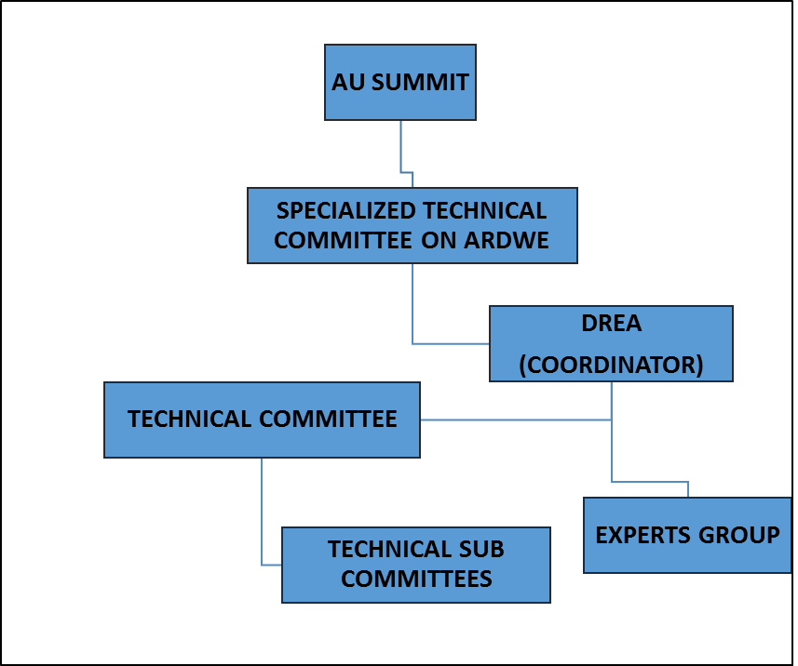
Coordination Structure/Mechanism
Experts Group: Rolling out country specific actions on the implementation of the strategy
Implementation: Monitoring and Reporting Framework
Coordination and Secretariat: AUC-DREA
AU Summit and STC: Political and strategic guidance

Slide 6
Implementation
Experts Group for the implementation of the Continental Strategy was established and operationalized - held its first sitting in September 2017: the most recent in Addis Ababa – Chaired by Kenya – Key outcomes (M&E, CITES, Advocacy)
Monitoring and Reporting tool for the Strategy developed and endorsed by the STC on ARDWE in October 2019
High level event on Corruption and the illicit Exploitation of Africa’s Natural Resources: Fisheries, Forests and Wildlife held on 8 Feb 2019 on the margins of the AU Assembly

Slide 7
Monitoring and Reporting Tool

Slide 8
Review of existing strategies
African Strategy to Combat Illegal Exploitation and illegal Trade in Wild Flora and Fauna in Africa May 2015
East African Community Strategy to Combat Poaching, Illegal Trade and Trafficking of Wildlife and Wildlife Products 2017/18-2021/22
Economic Community of West African States Combating Wildlife Trafficking in West Africa: A Guide for Developing a Counter Wildlife Trafficking Response
European Union Action Plan Against Wildlife Trafficking
Intergovernmental Authority on Development Regional Strategy Wildlife Management July 2017
Southern Africa Development Community Law Enforcement and Anti-Poaching strategy
United States National Strategy for Combating Wildlife Trafficking February 2014

Slide 9
Comparison

Slide 10
1. Political Commitment
Focuses on the prioritization of governments, organizations and institutions in supporting local, regional, trans-boundary, continental and global efforts to combat IWT
Political commitments to combat IWT at a local, national, trans-frontier, regional economic community or continental level; efforts may be directed at source, transit, or consumer/designation levels.

Slide 11
Questions - Political Commitment
Does your country have a current strategy to combat IWT?
How many instruments has your country joined or ratified this year?
How many IWT conventions or meetings has your Member State participated in this year?
How many awards or commendations has your country received this year with regards to IWT efforts?
How many awards or commendations has your country received this year with regards to IWT efforts?
What success factor(s) apply to this strategic area and which indicators are the factors linked to?

Slide 12
2. Regional and International Collaboration
Questions in this section focus on collaboration, coordination and cooperation at different levels and with the potential to influence IWT.
For example, cooperation among source, transit and destination countries; Support establishment of regional law enforcement networks, development of law enforcement agreements such as reciprocal enforcement agreements or harmonization of legislation at regional and sub-regional levels, etc

Slide 13
Questions: Regional and International Collaboration
Joint dialogue sessions have been held
New agreements have been signed or implemented that involve regional or international cooperation
New partnerships have been identified or forged
New joint initiatives or operations identified or forged
Formation of new networks
Has information sharing across all networks to which you belong increased, stayed the same, or decreased
Has information sharing across all networks to which you belong increased, stayed the same, or decreased
What key achievement(s) are associated this strategic area and which indicator(s) are the achievements linked to
What success factor(s) apply to this strategic area and which indicators are the factors linked to?

Slide 14
3. Enforcement and Compliance
Focus on efforts to strengthen the ability of law enforcement and judicial systems to combat wildlife trafficking across source, transit and destination locations. For example, capacity building for deterrent efforts, proactive enforcement, strengthening judicial and regulatory frameworks and promoting use of technology in wildlife investigations and prosecutions.
Questions also focus on the extent to which local communities and Indigenous Peoples are engaged in enforcement designed to deter crime and compliance activities designed to enable rule following

Slide 15
Questions: Enforcement and compliance
Any new laws, policies or legal reforms passed?
How many programs have been developed to support community compliance with laws, policies or legal reforms?
How many programs have been developed to support instructional or organizational compliance with laws, policies or legal reforms?
How many arrests have been made?
How many prosecutions have been made?
How many sentences have been passed?
Have human resources or institutional capacity for strengthened enforcement and compliance efforts increased, stayed the same, or decreased?

Slide 16
Questions: Enforcement and compliance
How many officials along the law enforcement and criminal justice chain have been trained? (please specify a number for each category)
Border officials
Clerks
Customs officials
Inspectors
Intelligence analysts
Investigators
Judges/Magistrates
Military
Other (specify)
Police
Prosecutors
Rangers (community, other)

Slide 17
Questions: Enforcement and compliance
What has been the primary focus of law enforcement, customs, and judicial sector training, where applicable? (please select all that apply)
Approximately what percentage of local community members are represented in management and decision making boards?
Approximately what percentage of Indigenous Peoples are represented in management and decision making boards?
Cooperation/Coordination
Corruption resistance
Crime statistics/analysis
Interviewing techniques
Intelligence analysis
Evidentiary standards
Financial investigations
Monitoring
Special investigations
Technology

Slide 18
Next Steps
Focal points at national level to coordinate the collection of data for the Monitoring and Reporting tool
Status report to be submitted to the AU Policy Organs
Aligning of national and regional Strategies to the continental strategy
Partnerships (MS, RECs, UN agencies CSOs)

Slide 19
Contacts
1. Harsen Nyambe Nyambe
Head, ECCWLM Division
Email: NyambeH@africa-union.org
2. Leah Wanambwa Naess
Senior Policy Officer
Email: WanambwaL@africa-union.org

Slide 20
Thank you

